Slide 1

HCI - Chapter 5

Slide 2

Menu and Navigation Schemes
  To exhibit a system’s functions.
Selection of Windows
  To view a certain part of the system or function.
Selection of Device based controls
  Input devices to communicate with the system.
Selection of Screen based controls
  Graphic objects that present properties of other objects.

Slide 3

Defines the amount of control given to the user in performing a task.
Single menus
Sequential linear menus
Simultaneous menus
Hierarchical menus
Connected menus
Event-trapping menus

Slide 4

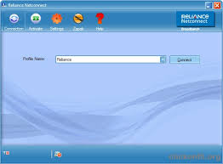

Slide 5

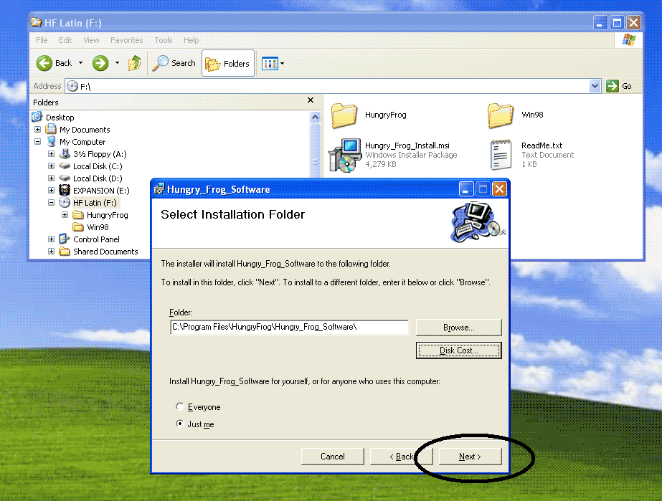

Slide 6

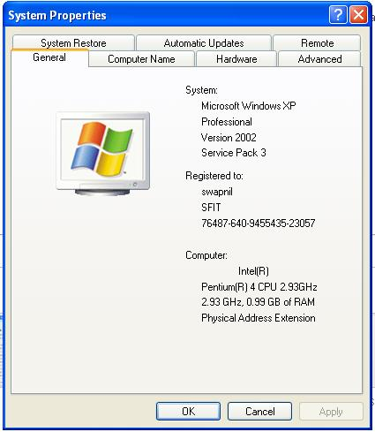

Slide 7

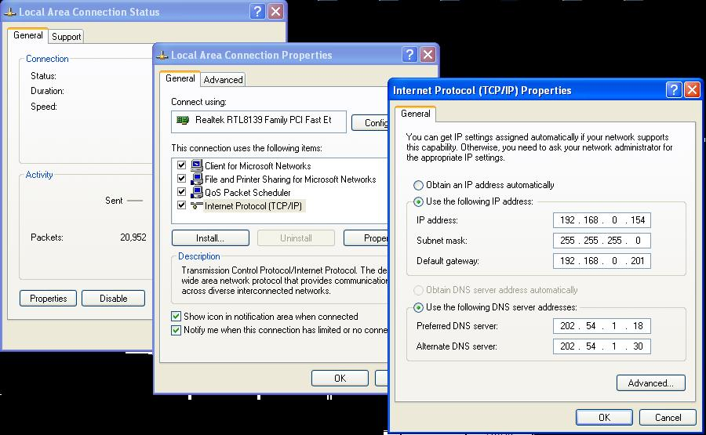

Slide 8

Navigation to a new menu
Execute an action or procedure
Display information
Data or parameter input

Slide 9

Menu context
  Nature and purpose of menu itself and its choices
Menu title
  Short, simple, clear and distinct titles
Choice descriptions
Completion instructions

Slide 10

Menu instructions
  Consider both novice and expert users.
  Meaningful
  Consistent
  Unique Keyword first
  Word as a command to computer
  Task-oriented wording (Verb first)
  Relationship to title

Slide 11

Intent indicators
  Helps in making your system more predictable.
Keyboard selection
  Ability to select a menu through keyboard.
  Key should have meaningful association with the menu.
  Follow industry standards.
Keyboard accelerators
  Help perform actions without choosing from menu.

Slide 12

Consistency
  The more predictable, the better.
Display
  Continual or on-demand
Presentation
  Obvious look. Different from other components.
Complexity
Item arrangement
  Top align or left align
Ordering
  Natural, numeric, alphabetic, frequency of use.
Groupings
  Cluster choices into no more than 6-7 groups with good visual separation.

Slide 13

Initial cursor positioning
Choice selection
  Pointers
  Keyboard
  Selection/ execution
  Combining techniques
Defaults
Unavailable choices
  Dimming or graying of disabled choices

Slide 14

Menu bar
  Highest level of a hierarchical structure.
  Selection of these should not perform any task.
  Located at the top of the screen with some unique background.
Pull-Down menu
  Display actions available to user.
  For small number of rarely changing choices.
  Could be placed just below the menu bar.
Cascading menus
  When two or more alternatives can be grouped together.
  User should be indicated with a bold right arrow head.

Slide 15
Pop-Up menu
  Activated on right click. Appear on working area.
Tear-off menu
  Can be positioned anywhere on the screen.
  Can be made hidden or visible by user.
Iconic menu
  Menu items are represented in pictorial form.
Pie menu
  Circular representation of menus.
Default menu items
  E.g. File -> new, open, save, print, exit

Slide 16

A window is an area of the screen, usually rectangular in shape, defined by a border that contains a particular view of some area of the computer or some portion of a person’s dialog with the computer.
Window Characteristics
  Title - Identified with a name
  Size - Variable/ fixed height and breadth
  State - Active/ inaccessible
  Visibility – portions of the screen seen
  Location – relative to screen boundary
  Presentation – tiled/ overlapped/ cascaded
  Function – application to which it is dedicated.

Slide 17

Presentation of different levels of information
Presentation of multiple kinds of information
Sequential presentation of levels or kinds of information
Access to different sources of information
Combining multiple sources of information
Performing more than one task
Reminding
Monitoring
Multiple representations of the same task.

Slide 18

Frame
Title bar
Title bar icon
Window sizing buttons
What’s this ? Button
Menu bar
Status bar
Scroll bar
Split box
Tool bar
Command area
Size grip
Work area

Slide 19

Tiled
  Single task activities
  Simultaneous view in all windows
  For tasks that require little window manipulation
Overlapping
  Switching between tasks
  Greater window manipulation
  Display is unpredictable
Cascading
  Multiple task activities
  Greater window manipulation
  Greater visual clarity

Slide 20

Primary window
Secondary window
  Modal and modeless
  Cascading and Unfolding
Dialog box
Property sheets
Message box
Palette windows
Pop-up windows

Slide 21

Single document interface
Multiple document interface
Workbooks
Projects

Slide 22

Active window
Opening a window
Sizing windows
Window placement
Window separation
Moving a window
Resizing a window
Window shuffling
Keyboard control
Closing a window

Slide 23

Input devices through which user communicates with the computer.
Characteristics:
To POINT at an object
To SELECT the object
To DRAG an object
To DRAW anything
To TRACK or follow a moving object
To ORIENT or position an object
To ENTER or manipulate data

Slide 24

Description:
  A ball that rotates freely in its socket.
  Direction and speed of rotation is tracked and translated into cursor movement.
  Commonly used with laptops/ notebooks.
Advantages:
  Direct relationship between hand and pointer.
  No additional desk space required
Disadvantages:
  Plane of ball movement is different from pointer plane. Hence requires greater hand-eye co-ordination
  May be difficult to control, and fatiguing after some time.

Slide 25

Description:
Advantages:
Disadvantages:

Slide 26

Description:
Advantages:
Disadvantages:

Slide 27

Description:
Advantages:
Disadvantages:

Slide 28

Description:
Advantages:
Disadvantages:

Slide 29

Description:
Advantages:
Disadvantages:

Slide 30

Description:
Advantages:
Disadvantages:

Slide 31

Description:
Advantages:
Disadvantages:

Slide 32

Task characteristics
User characteristics and preferences
Environmental characteristics
Hardware characteristics
Device in relation to the application
Minimising eye and hand movements

Slide 33



Slide 34


